Slide 1
LENDING CLUB CASE STUDY SUBMISSION
Group Members:
Md Ashif Ali
Manikanta Ambadipudi

Slide 2
Case Study Objectives
Identification of risky loan applicants using EDA.
Find the ‘Driving Factors’ or ‘Driver Variables’ behind the loan default phenomena.

Slide 3
Problem solving methodology
Lending Club Case Study Flow Chart
START
UNDERSTANDING THE DATASET
DATA CLEANING AND HANDLING MISSING DATA
EXPLORATORY DATA ANALYSIS
(UNIVARIATE ANALYSIS, SEGMENTED UNIVARIATE ANALYSIS AND BIVARIATE ANALYSIS)
DATA PREPARATION

Slide 4
Analysis Methodology
We have performed Univariate and Bivariate Analysis on all the variables and arrived at the following variables:
Grade
Purpose
Term
Annual Income
Interest Rate
Loan Amount
The univariate analysis and bivariate analysis (only for the important/key variables) for the above variables have been plotted in the following slides.

Slide 5
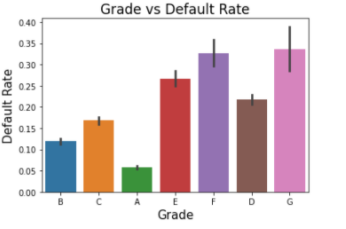

Univariate Analysis on Grade
Looking at the Bar plot to the left we can notice that applicants with grade G have defaulted the highest.
But looking at the percentage of applicants for each grade, we can see that percentage of applicants falling under grade G is less than 1, and hence considering this would yield skewed results. We will be ignoring this variable for the purpose of our analysis.
The above applies for grade F as well and hence we will be ignoring grade F for the purpose of the analysis as well.
This leaves us with grade E having the highest default rate.
We can conclude that applicants with grade E have defaulted the most.
Percentage of total counts of each Category:

Slide 6
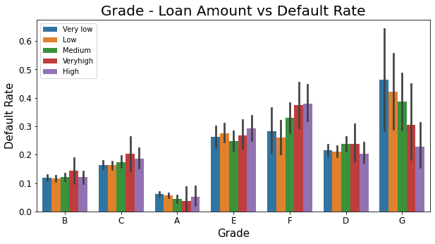
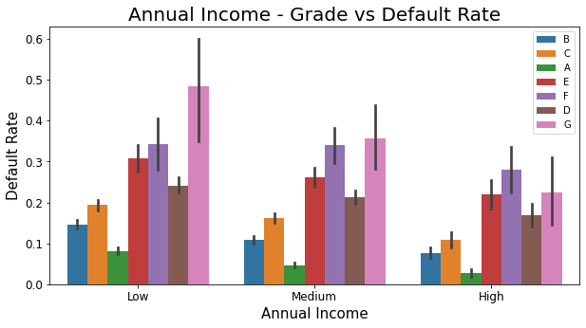


Bivariate Analysis on Grade
Loan Amount Categories:
The graph on the left shows how grade performs for different loan amount categories.
Excluding grades F and G (for the reason mentioned in Slide 5) we can notice that applicants with a High loan amount from grade E have defaulted the most when compared to other categories
The graph on the right shows how grade performs for different Annual Income Categories.
We can see that applicants with Low Income Category from grade E have defaulted the most.
Annual Income Categories:

Slide 7
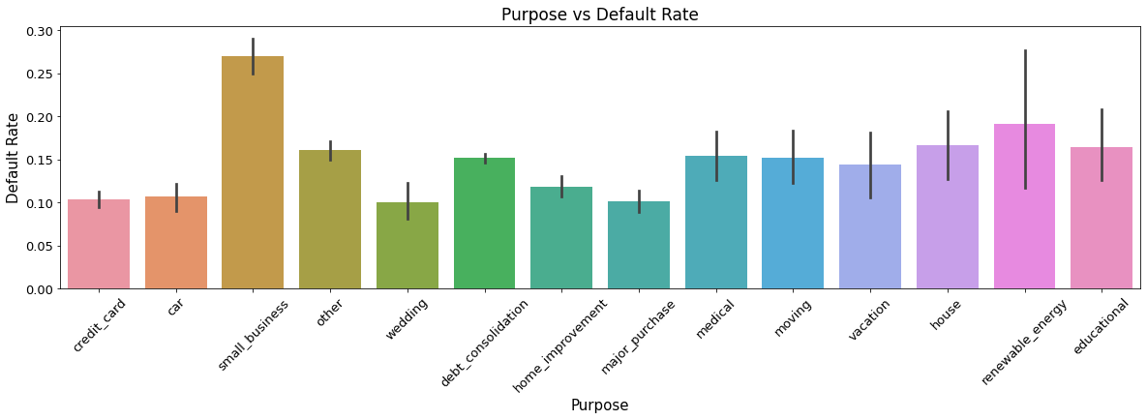
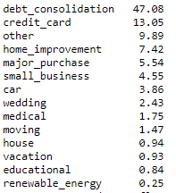
Univariate Analysis on Purpose
Percentage of Applicants for each category of Purpose:
We will be considering only the top 6 purposes as the rest have very small percentages of applicants.
Looking at the graph above, we can see that the applicants that have mentioned the purpose of the loan as Small Business have defaulted the most

Slide 8
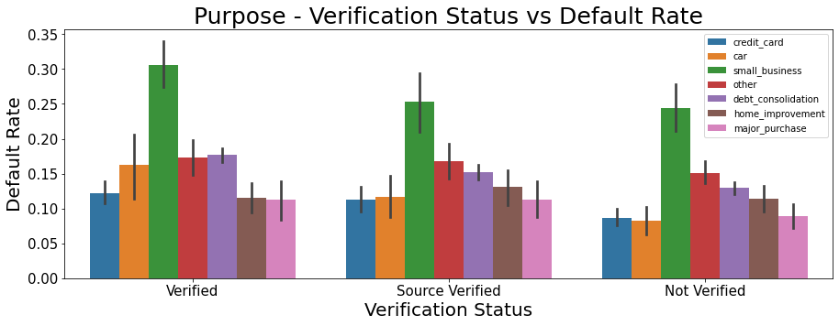
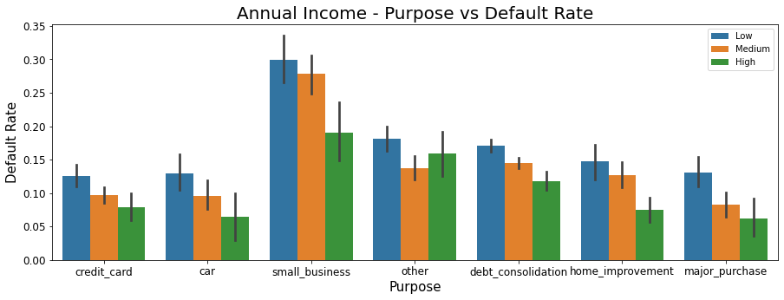
Bivariate Analysis on Purpose
The first graph to the left shows how the Loan Purpose performs with Verification Status mentioned by the applicants.
We can see that majority of the applicants defaulted when the purpose was Small Business and the Verification Status was Verified.
The second graph shows how Purpose performs with the Annual Income of the applicants.
We can see that the default rate was the highest when the Purpose was Small Business and Annual Income was Low.
Annual Income Categories:

Slide 9
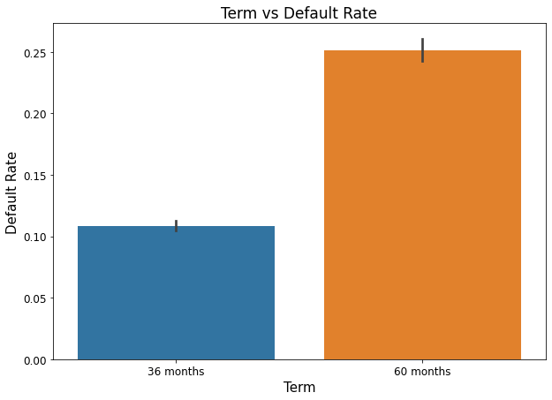

Univariate Analysis on Term
We will be considering both the Term Categories as the data is not very imbalanced.
Looking at the graph to the left, we can see that applicants who have opted for 60 month Term have defaulted the most.
Percentage of applicants categorized based on the Term they have opted for:

Slide 10
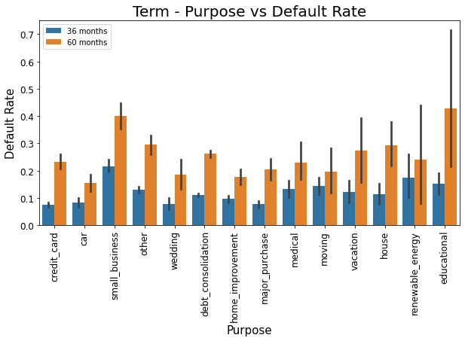
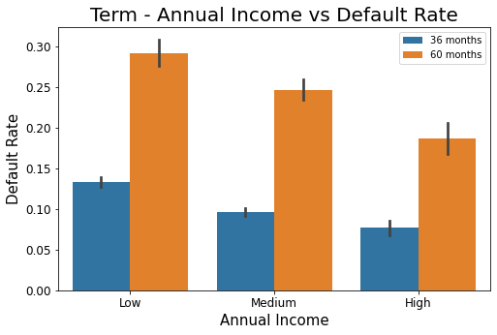
Bivariate Analysis on Term
Percentage of Applicants for each category of Purpose:
Annual Income Categories:
The graph to the left shows how Term performs with Purpose against the default rate.
We will ignore all the categories of purpose, below ‘small_business’ as the percentages of applicants for those categories are very small.
We can see from the Term-Purpose graph that most of the applicants that defaulted listed their purpose as Small Business and chose 60 months Term.
The graph on the right shows that majority of the defaulters had Low Annual Income and chose 60 months Term.

Slide 11
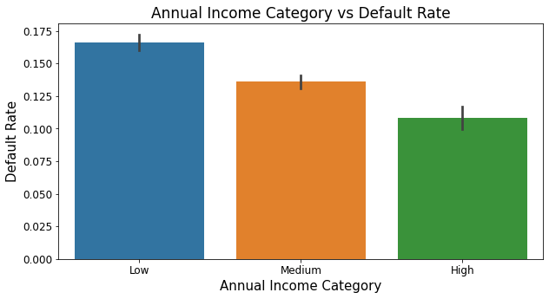
Univariate Analysis on Annual Income
Looking at the graph to the left, we can see that applicant with a Low Annual Income Category have defaulted the most
Annual Income Categories:
Low - Less than or equal to 50000
Medium – Greater than 50000 but less than or equal to 100000
High – Greater than 100000
Note: Bivariate Analysis on Annual Income has been covered in the previous slides.

Slide 12
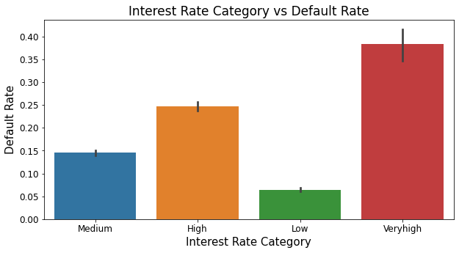

Univariate Analysis on Interest Rate
We will be ignoring Interest Rate Category ‘ Very High’ as the percentage of applicants for that category is very less and insignificant.
As shown in the graph to the left, we can see that the default rate is the highest when the Interest Rate is High.
Interest Rate Categories:
Low: <= 10 %
Medium: 10 to 15 %
High: 15 to 20 %
Very High: > 20%
Percentage of applicants for each Interest Rate Category:

Slide 13
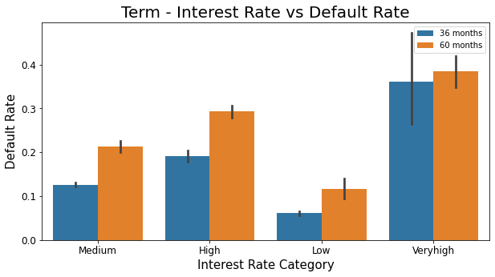
Bivariate Analysis on Interest Rate
We will be ignoring the ‘Very High’ category of the Interest Rate as the percentage of applicants for that category is very less.
Looking at the graph to the left, we can see that applicants with High Interest Rate have defaulted the most when the Term is 60 months.

Slide 14
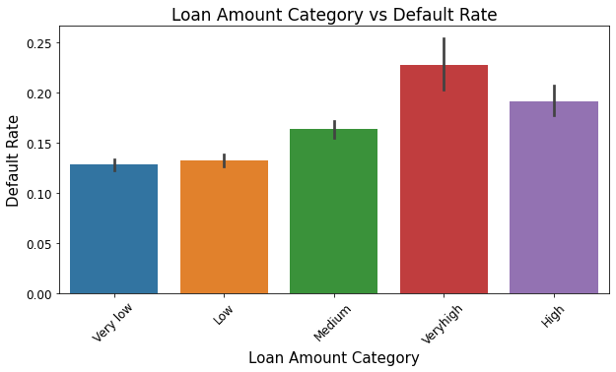

Univariate Analysis on Loan Amount
We will be ignoring Loan Amount Category ‘Very High’ as percentage of applicants for this category is very less.
The graph to the left shows that, higher the loan amount the higher the default rate.
We can conclude that applicants with High loan amount have defaulted the most.
Loan Amount Categories:
Very Low: <= 7000
Low: 7000 to 14000
Medium: 14000 to 21000
High: 21000 to 28000
Very High: > 28000
Percentage of applicants for each Loan Amount Category:

Slide 15
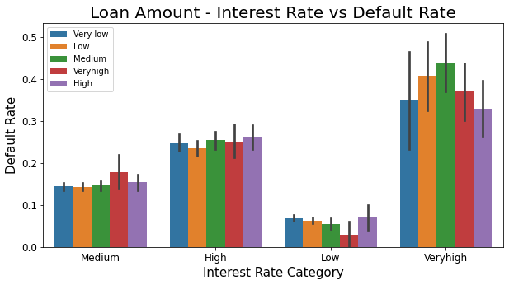
Bivariate Analysis on Loan Amount
We will ignore Very High Loan Amount and Very High Interest Rate categories as the percentages of applicants for these 2 categories are very less.
We can see from the graph to the left that when the Loan Amount and Interest Rates are High, the Default Rate is also High.
Interest Rate Categories:
Low: <= 10 %
Medium: 10 to 15 %
High: 15 to 20 %
Very High: > 20%
Percentage of applicants for each Interest Rate Category:
Note: We have one more graph plotted, between Grade, Loan Amount vs Default Rate and can be found in the slide 6.

Slide 16
Conclusion
The following are the Driver Variables that lead to a potential loan default:
Grade: Higher the grade (A to G with G being the highest and A being the lowest), higher the chance of default. Most defaults were seen for the Grade E.
Purpose: Highest default rate was observed for the loan purpose – Small Business
Term: Default rate was the highest for 60 months Term.
Annual Income: Lower the annual income higher the chance of default. Highest default rate was observed for Low Annual Income (< 50000).
Interest Rate: Higher the interest, higher the default rate. Highest default rate was observed for High Interest Rate (15 – 20 %).
Loan Amount: Higher the loan amount, higher the default rate. Highest default rate was observed for High Loan Amount (21000 to 28000).

